Slide 1
Optimus PrimeTime: The Game
Mason Caird, Casey Sweet, and Daniel Tucker

Slide 2
A Quick Overview
For those among us unfortunate enough to live in places that aren’t BMac:
Optimus PrimeTime is a NERF war staged in the magnificent McMillan Hall
At the end of the night, we finish off the game with a round or two of zombies.
Simple enough, right?

Slide 3
Classes
Zombie
Wall
ZombieSpawner
Player
Bullet

Slide 4
GUI
The majority of the game resides in a LayeredPane
Intro Layer
Window Game Layer

Slide 5
Concepts from Class
The whole GUI
Multi Threading
Extending classes and Implementing interfaces
(KeyListener, MouseMotion, MouseListener)

Slide 6
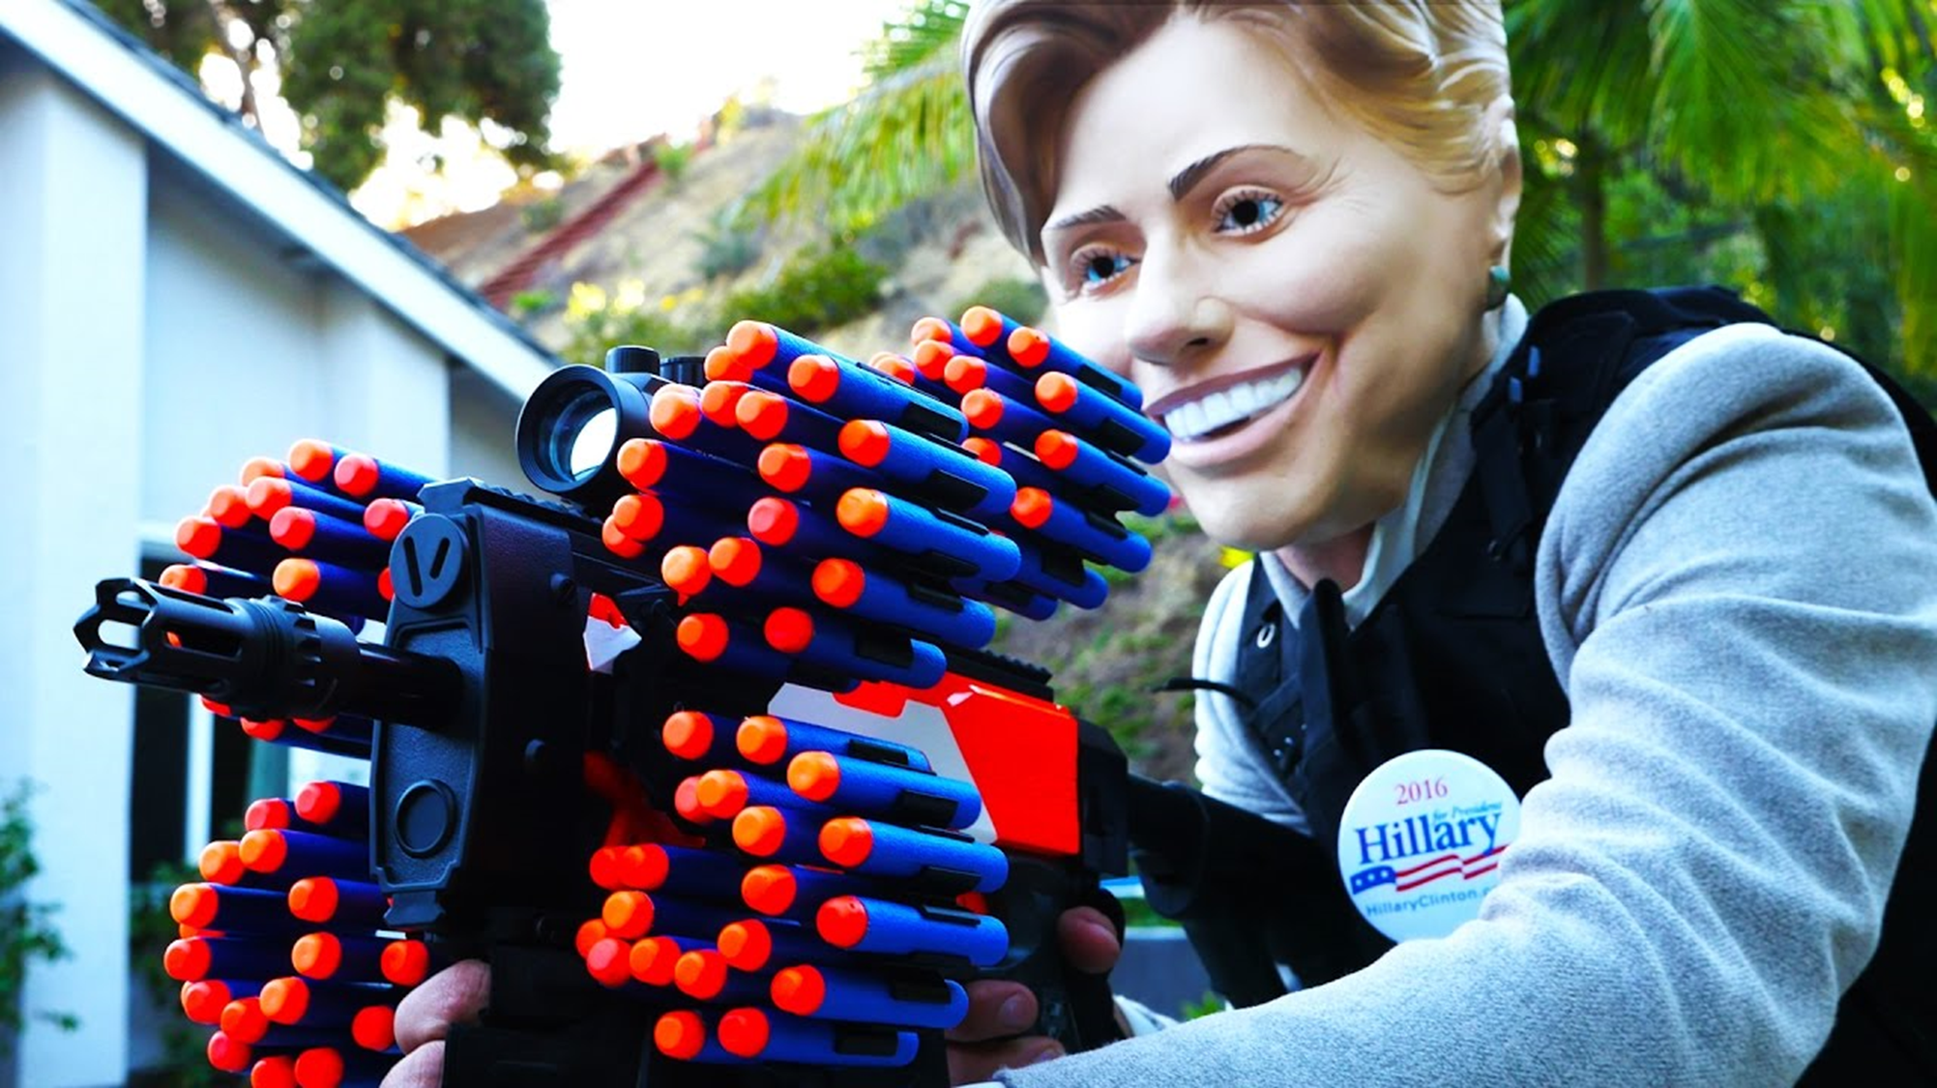

Not Sponsored

